Slide 1
We found Wireless in a wired place
Rushad Antia

Slide 2
Contents
Motivation / Objectives
Software
Testing Setup
Tests
Conclusion

Slide 3
Disclaimer
"Certain commercial equipment, instruments, or materials are identified in this paper in order to specify the experimental procedure adequately. Such identification is not intended to imply recommendation or endorsement by the National Institute of Standards and Technology, nor is it intended to imply that the materials or equipment identified are necessarily the best available for the purpose."

Slide 4
Motivation
Can wireless replace wired in a factory setting?
Wired | Wireless
+ Reliable | + Inexpensive
+ More secure | - Prone to attacks
- Expensive | - Unreliable

Slide 5
Objectives
Develop a Publish/Subscribe network package in Node.js (javascript)
Create a tool to monitor sensor nodes
Create tools to log and capture data from nodes
Connect nodes to RF Channel Emulator to test performance of wireless in simulated environments
Analyze Data

Slide 6
Software

Slide 7
Publish / Subscribe Network
Written in Node.js
Each node acts as a client and server
Nodes connect to a “Master Node” that brokers connections between nodes
Nodes connect over TCP/IP to other nodes and subscribe to topics that other nodes publish
Edison01
Has:
Wants: Button, Light
Edison03
Has: Button
Wants: Light
Edison05
Has:
Wants: Button, Light

Slide 8
Node Joining the Network
Edison05
Has:
Wants: Button, Light
Edison03
Has: Button
Wants: Light
Edison02
Has: Light
Wants: Button
Edison01
Has:
Wants: Button, Light
Edison03
Has: Button
Wants: Light
Edison04
Has:
Wants: Button, Light
Edison01
Has:
Wants: Button, Light
Edison05
Has:
Wants: Button, Light
Edison06
Has:
Wants: Button, Light
Edison04
Has:
Wants: Button, Light
Edison06
Has:
Wants: Button, Light

Slide 9
Master Node
Server that runs on a PC on the network
Brokers the connections between nodes based on their Publish/Subscribe needs
Acts as a webserver that hosts a website to monitor and interact with all alive nodes on network
Each node connects to this node through TCP/IP

Slide 10
Edison Control Center

Slide 11
Testing setup

Slide 12
Testing Setup
“Edison03” node emits a ON/OFF pulse (button push) to all nodes in the network every 100ms
Events emitted over TCP/IP through the router in infrastructure mode
Nodes connected to RF Channel emulator to simulate various environments

Slide 13
Signal Generator
Edison03
Edison01
RF Channel Emulator
Edison02
Oscilloscope
Wi-Fi Router
Edison05
Edison06
PC

Slide 14
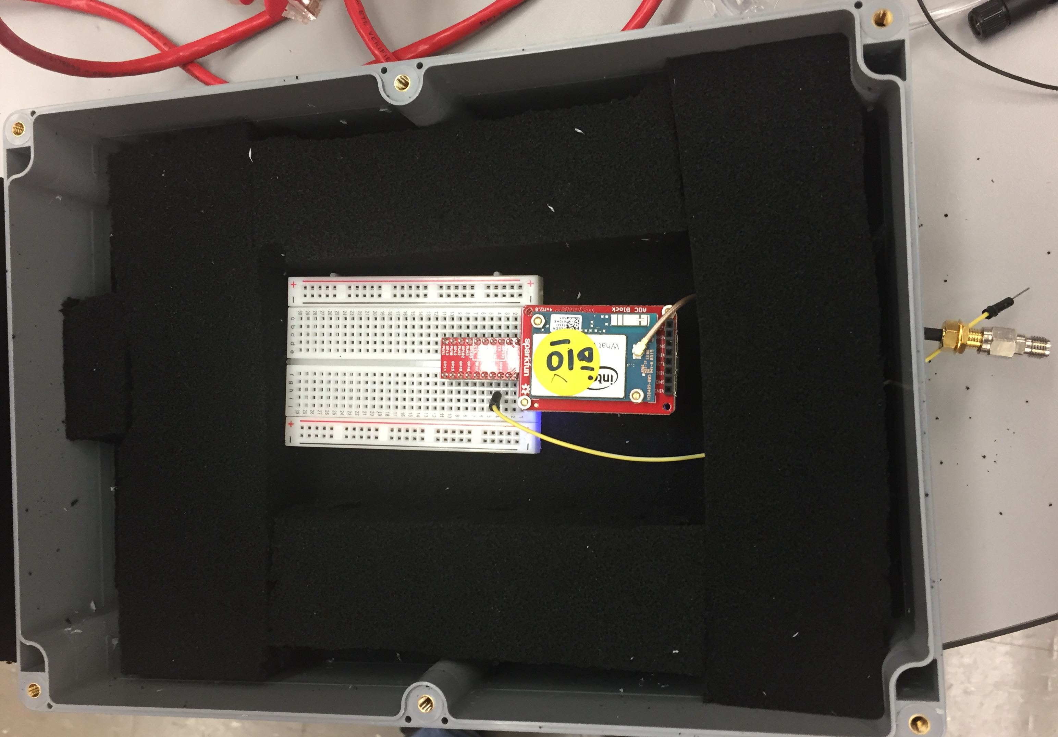
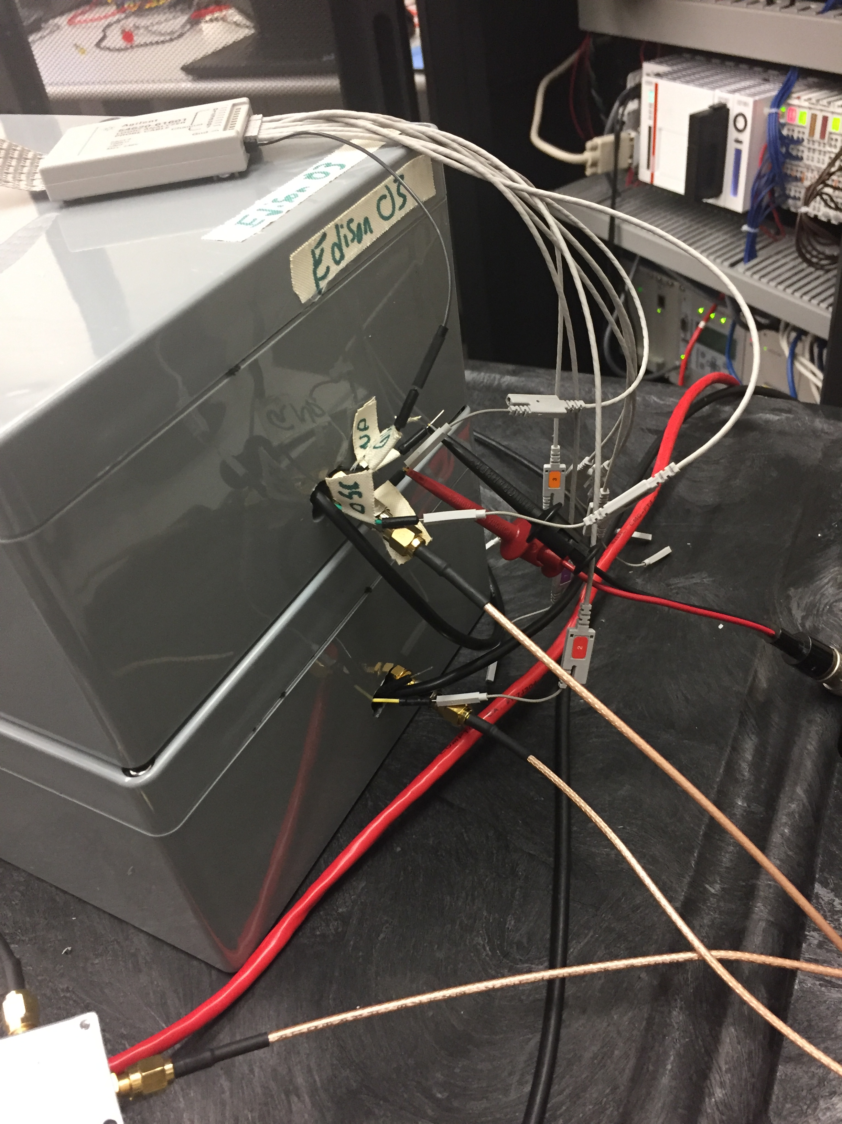
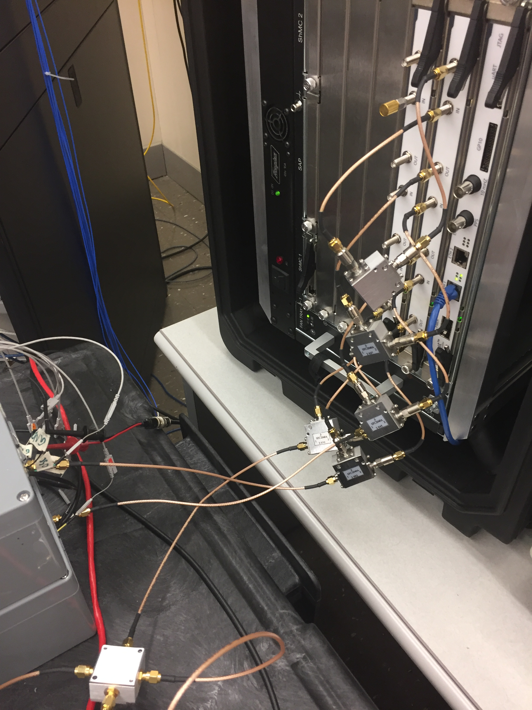
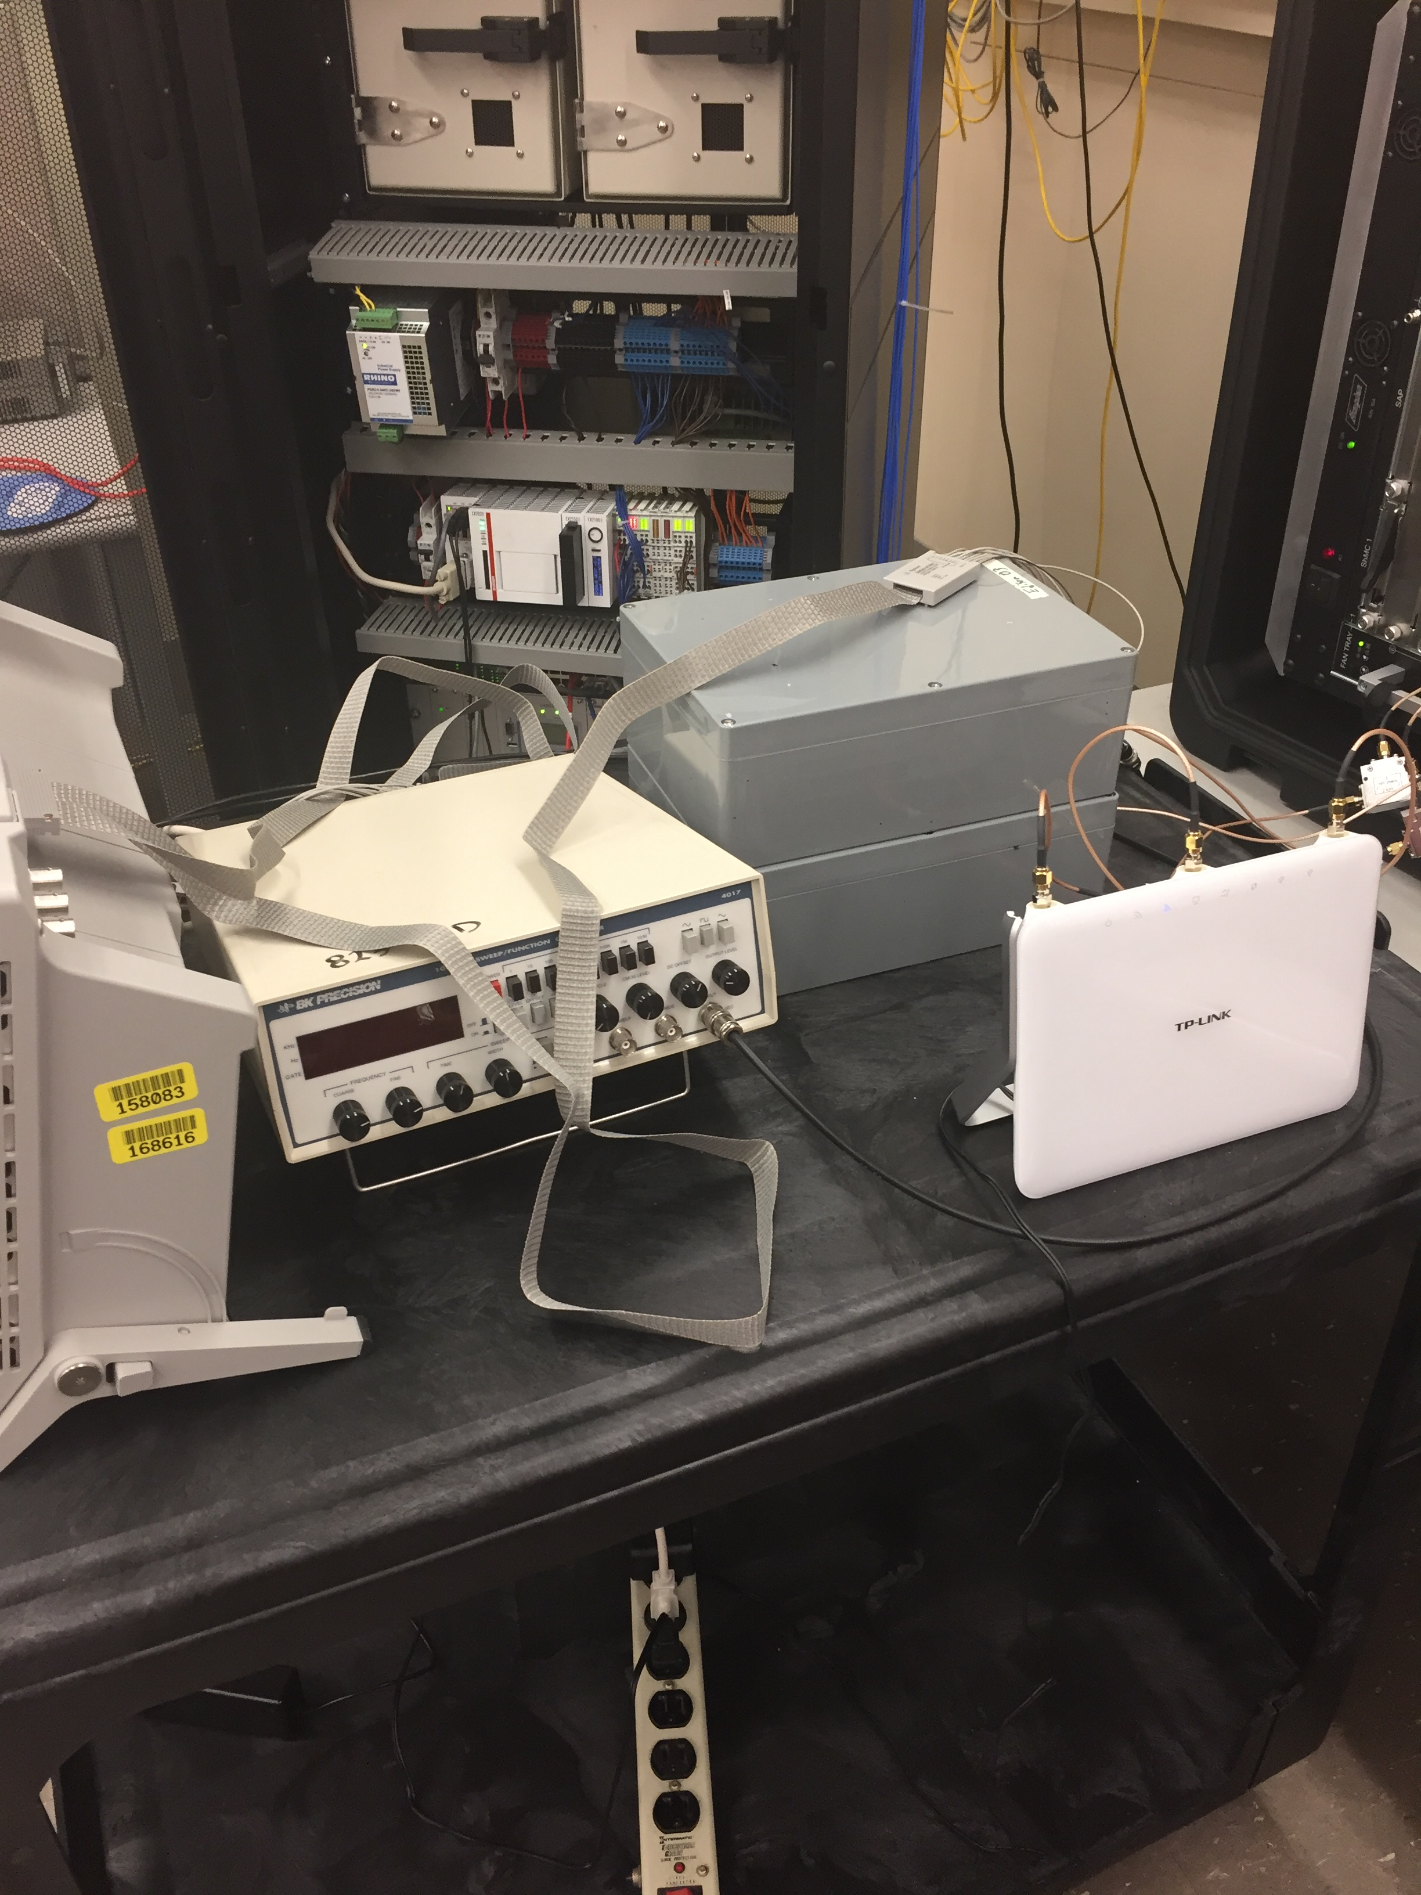
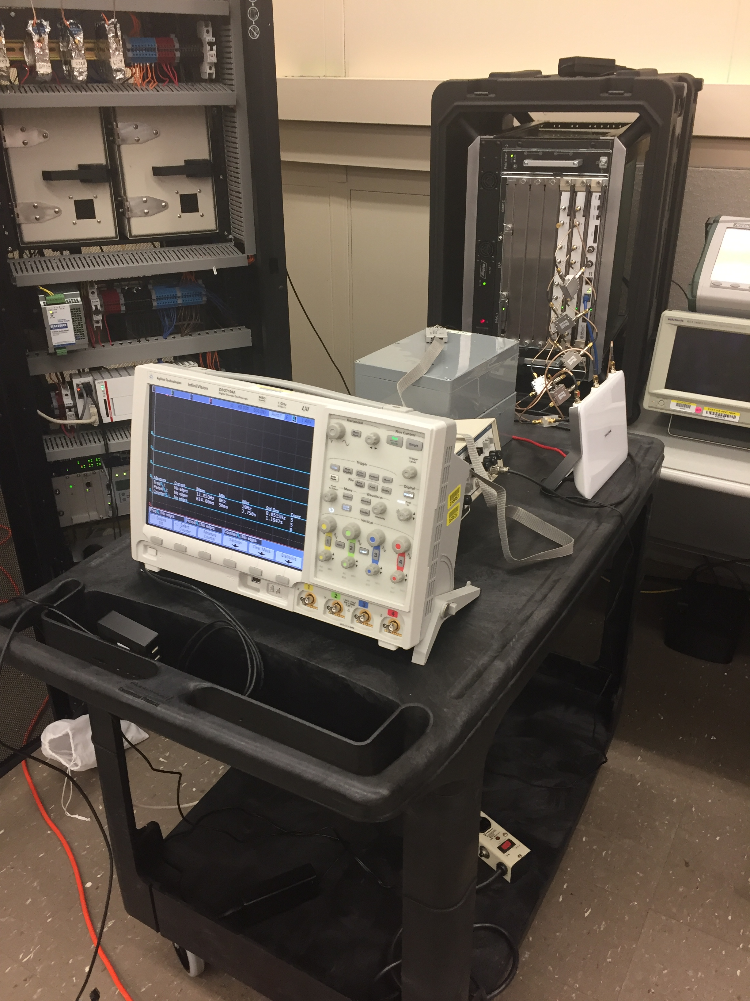

Slide 15
Testing

Slide 16
Test Cases
The RF Channel Emulator allows us to create a multitude of test cases
180 tests total
802.11 b/g
Free space
Mobile
Line of sight
20 MHz
Stationary
802.11 n
No line of sight
40 MHZ

Slide 17
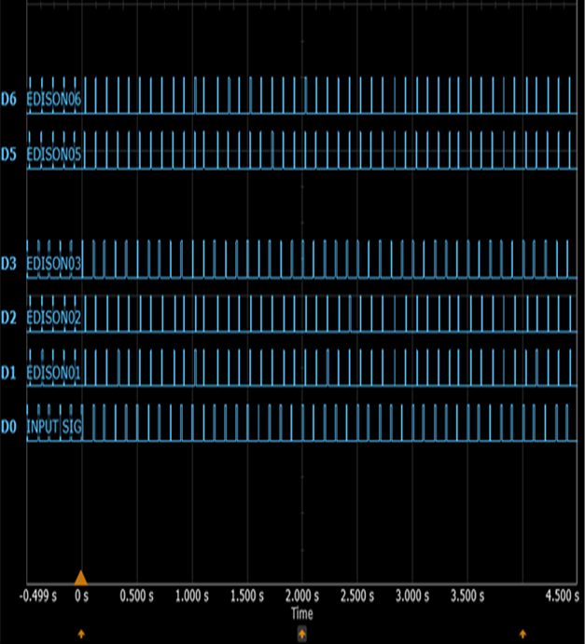
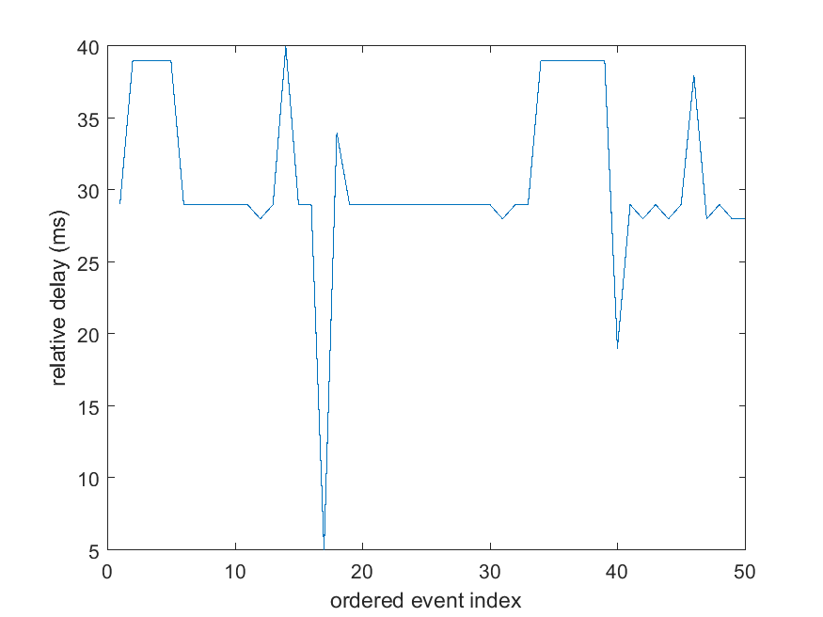
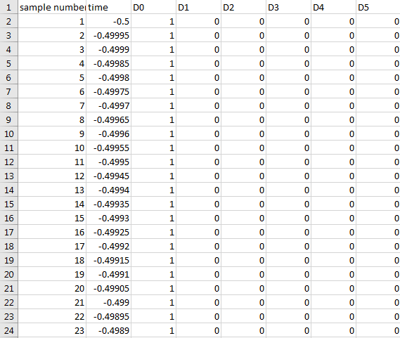
Example Data capture
Captured oscilloscope data through PC and exported to csv
Imported csv capture into MATLAB to compute latency between devices

